Slide 1
New Measurements of Hygroscopicity- & Size-Resolved Particle Fluxes
Brittany Phillips, K. Dawson, T. Royalty,
R. Reed, M. D. Petters, and N. Meskhidze
Marine, Earth, and Atmospheric Science – NC State
October 7, 2015
14th Annual CMAS Conference, UNC-Chapel Hill
Air Quality Measurements & Observational Studies

Slide 2
Objectives/Research Questions
Part one:
What is the fraction of sea-spray in the Marine Boundary Layer?
Part two:
Can we measure size- and hygroscopicity-resolved fluxes?

Slide 3
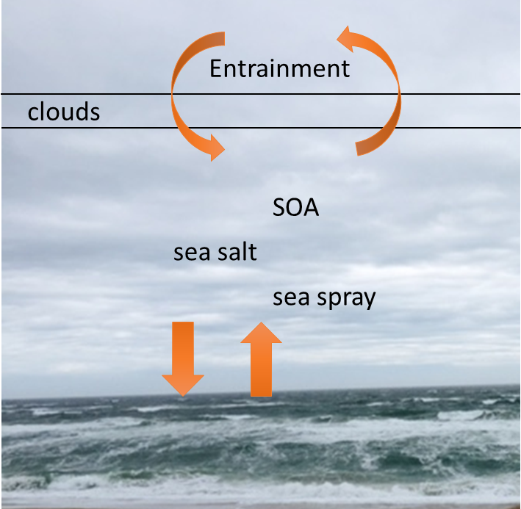
Motivation: why study sea-spray fluxes?
Marine Aerosol Impacts:
  Climate
  Human Health
  Chemical Reactions
Sea-spray aerosol number concentrations are low
Uncertainty in measurements are high

Slide 4
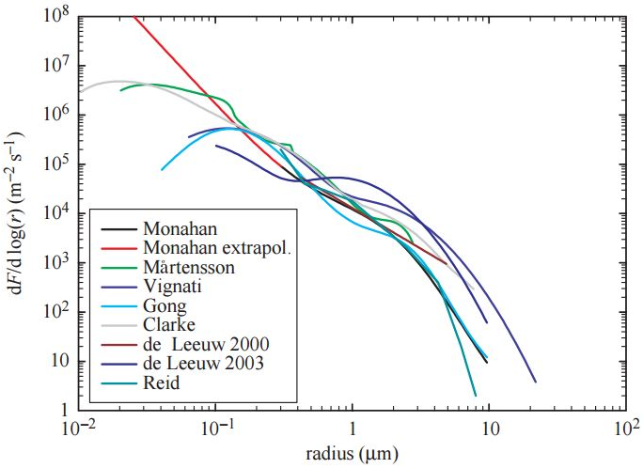
Current Literature on Sea-Spray Flux
140-260 nm in Diameter
Limited to a few data points
  Geever et al. 2005
  de Leeuw et al. 2007
  Norris et al. 2012
Measurement system needs to be able to measure a flux of ~10⁴ m⁻² s⁻¹
Source: O’Dowd and de Leeuw (2007)

Slide 5
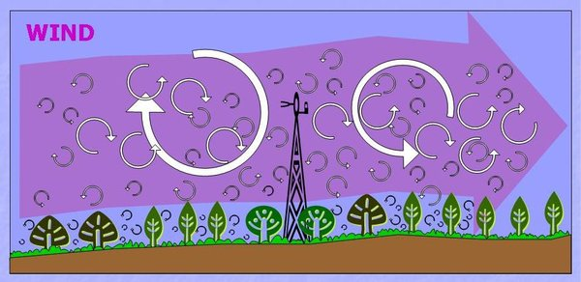

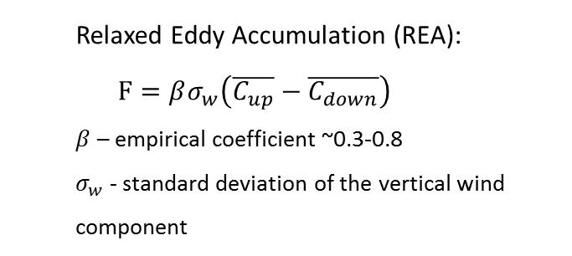
Flux Measurement Techniques
Eddy Covariance (EC): $F=\overline{w^{′}C^{′}}$
  Relaxed Eddy Accumulation (REA):
  $$F=βσ_{w}\left(\overline{C_{up}}−\overline{C_{down}}\right)$$
  $β$ – empirical coefficient ~0.3-0.8
  $σ_{w}$ - standard deviation of the vertical wind component
Concentration Gradient
Background Image Source: https://en.wikipedia.org/wiki/Eddy_covariance

Slide 6
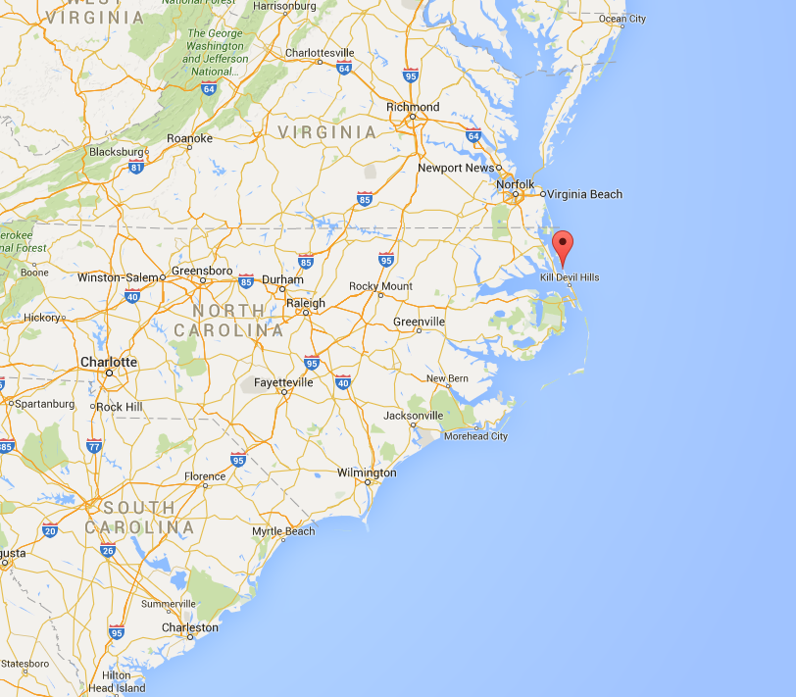
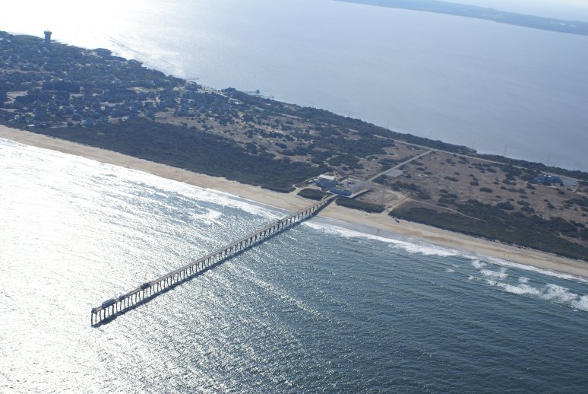
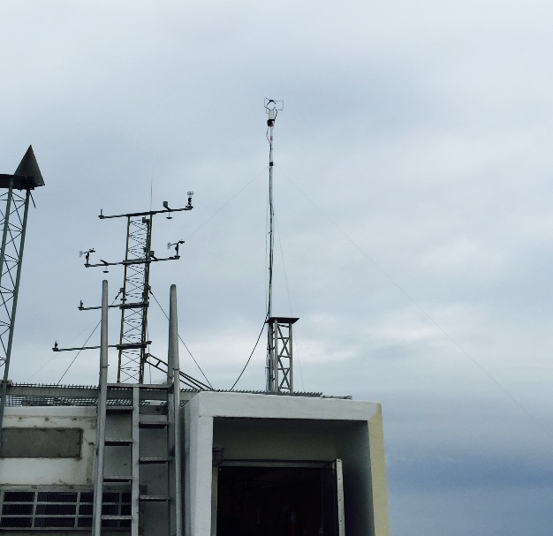
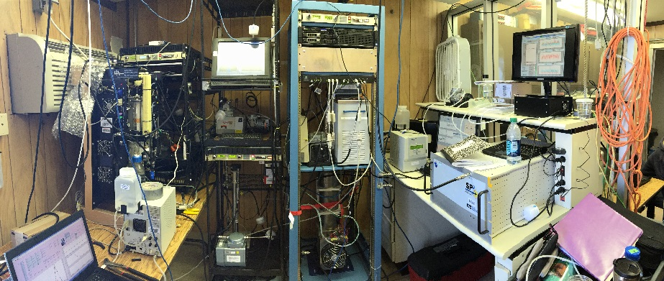
Duck Pier Site (North Carolina)
Preliminary deployment
Question: What is the expected concentration of sea-spray (and the wind speed dependence)?
U.S. Army Corps of Engineer’s Field Research Facility’s 560 meter long pier.
Duck, NC
Instrument Setup at the Pier
Source: Google Maps
Source: http://www.frf.usace.army.mil/

Slide 7
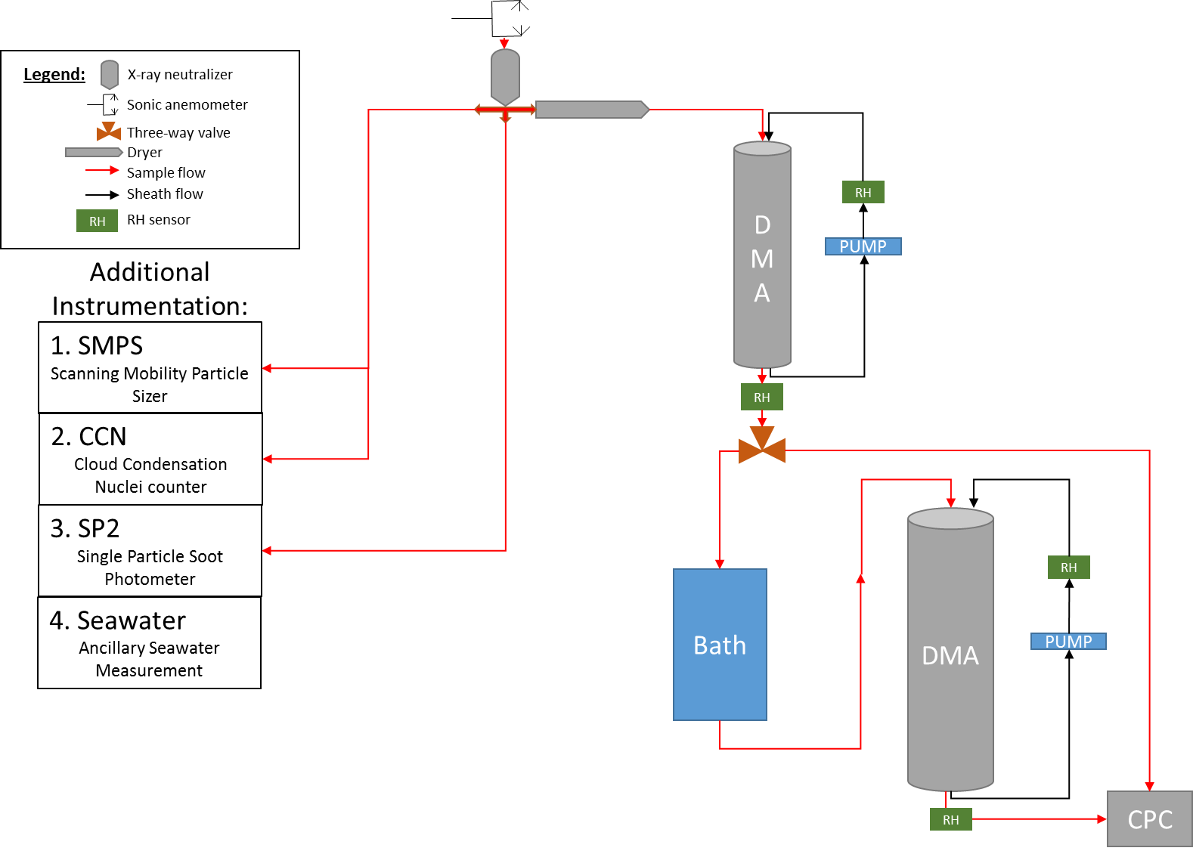


Measurement System (SMPS and Tandem DMA)
Sonic Anemometer
and
Aerosol Inlet
200 nm dry size selection
$$D_{d}$$
Humidification
Growth Factor
Distribution
RH: 80 %
$$D_{wet}(RH)$$
Notes:
Full system of instruments include
Sonic Anemometer- wind speed & direction, and temperature
HTDMA: Hygroscopicity Tandem Differential Mobility Analyzer- provides the growth factor distribution for size-selected particles (first DMA)
SMPS: Scanning Mobility Particle Sizer- provides particle size distribution over the range (550-10 nm) (sheath-to-sample flow rate ~5:1)
CCN: Cloud Condensation Nuclei Counter- counts the number of particles capable of activating as cloud nuclei (supersaturation range 0.09-1.25)
SP2: Single Particle Soot Photometer- measures black carbon mass on a particle by particle basis

Slide 8



Using hygroscopic growth factor to identify sea-spray concentration
200 nm Dry Sized Particle
RH: 80 %
Growth Factor
$$D_{d}$$
$$D_{wet}(RH)$$
$$gf=\frac{D_{wet}(RH)}{D_{d}}→κ=f(RH, gf)$$
Slightly Hygroscopic
Non Sea Spray
Sea-Spray
Very Hygroscopic
0 | 0.1 | 0.2 | 0.3 | 0.4 | 0.5 | 0.6 | 0.7 | 0.8 | 0.9 | 1.0 | 1.1 | 1.2 | 1.3 | 1.4 | 1.5 | 1.6 | 1.7
Kappa (Hygroscopicity Parameter)

Slide 9



Using hygroscopic growth factor to identify sea-spray concentration
$$κ<0.05$$
$$κ \sim 0.6$$
$$κ \sim 1.3$$
RH=20%
Black
Carbon
Dust
Ammonium
Sulfate
Sea-Salt
RH=80%

Slide 10
Growth factor distribution (@ RH = 80%)
Slightly Hygroscopic
Kappa (Hygroscopicity Parameter)
Very Hygroscopic

Slide 11
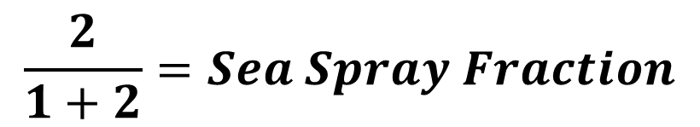
Derivation of sea-spray fraction
2
2
1
1
$$\frac{2}{1+2}=Sea Spray Fraction$$
Sea-Spray Fraction: 0%
Sea-Spray Fraction: 8.4%
Notes:
Low hygroscopicity parameter means slightly hygroscopic
High hygroscopicity parameter means very hygroscopic
Organic species (low to ~0.5)
Sea-salt (~1.3)

Slide 12
Two measurement modes
A
B
A. Scan a range of wet diameters
B. Set target kappa and obtain 1 Hz data
Notes:
Low hygroscopicity parameter means slightly hygroscopic
High hygroscopicity parameter means very hygroscopic
Organic species (low to ~0.5)
Sea-salt (~1.3)

Slide 13
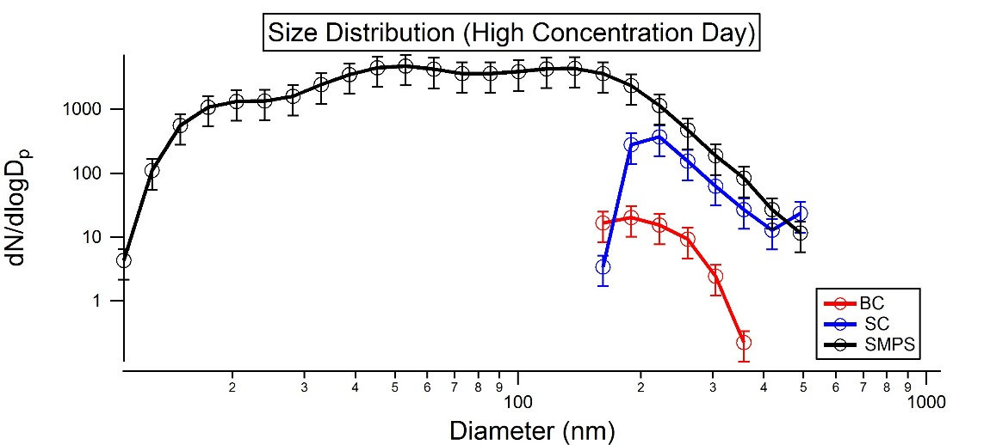
Aerosol Size Distribution
For 160-240 nm – Concentration varies between 15 and 300 particles/cm⁻³.

Slide 14
Sea-Spray Number Concentration (160-240nm)

Slide 15
Fraction of 200 nm sea-spray vs. wind speed
Wind Speed Histogram
Fraction
3 | 9 | 15 m/s
Higher fraction of 200 nm sized particles were sea-spray (kappa = 1.3) for greater wind speeds
High wind speeds occurred less often

Slide 16
Sea-Spray Concentration Summary
Sea-spray fraction of 200 nm particles at site varies from ~0-24%
Typical 200 nm sea-spray concentration ~1-10 cm⁻³
Next objective: Concentration → Fluxes
  Can flux be measured directly?
  HTDMA too slow for EC
Design and validation of REA system

Slide 17
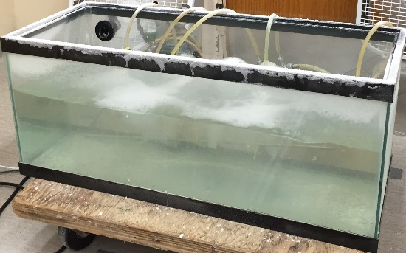
Hygroscopicity-Resolved Relaxed Eddy Accumulation Flux (Hy-RES REA)
Updraft/Downdraft Wind Speed Measurement
Legend:
Sonic anemometer
Three-way valve
Sample flow
HEPA Filter
Frit
HTDMA System
Sea Salt Aerosol Generation
Size-Selection
&
Growth Factor Distribution
Solenoid Valve Switching:
Zero Air
Updraft Concentration
Downdraft Concentration
80%
Notes:
This diagram represents the laboratory validation setup only.
Relaxed Eddy Field setup will include the SP2, SMPS, CCN, and HTDMA.
Two solenoid valves will be used to select up/down drafts separately.
Data presented represent the Wet-Diameter, dry diameters will be measured in the field setup.

Slide 18
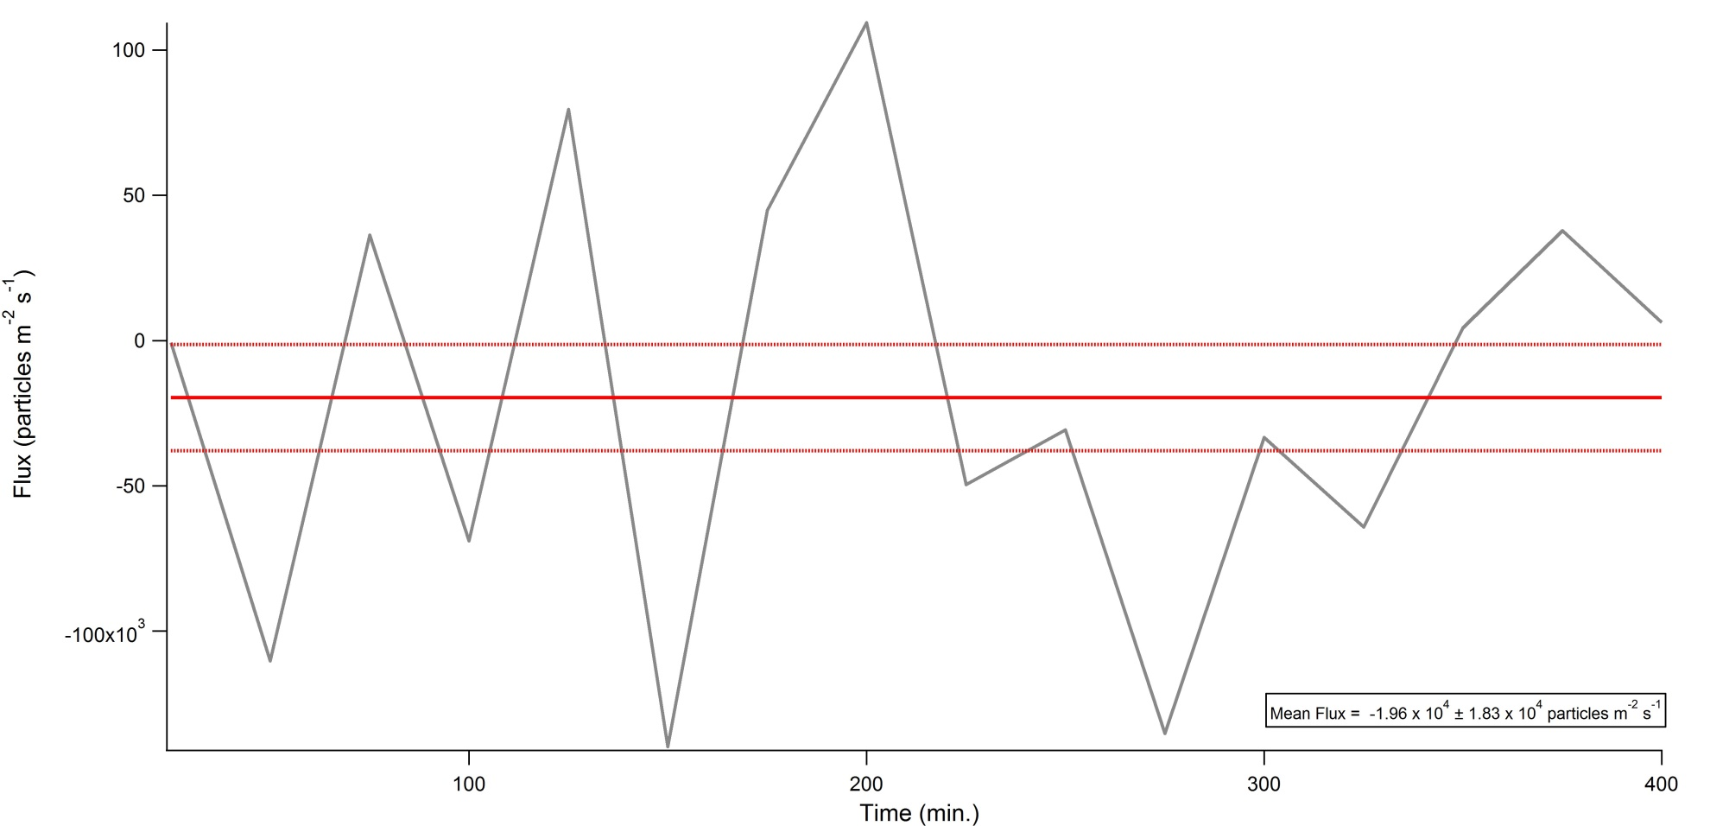
Preliminary System Results
NO Source
Background Lab
Laboratory Background Flux Time Series
Approximate Detection Limit:
~4.93 x 10⁴ m⁻² s⁻¹
Source: O’Dowd and de Leeuw (2007)

Slide 19
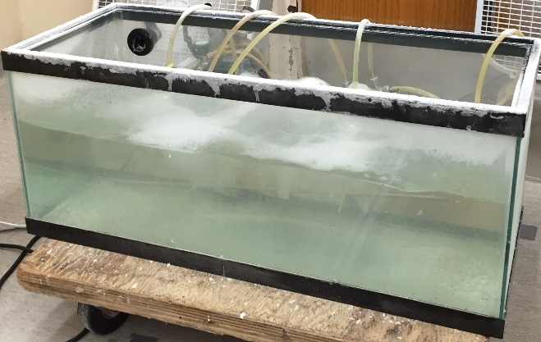
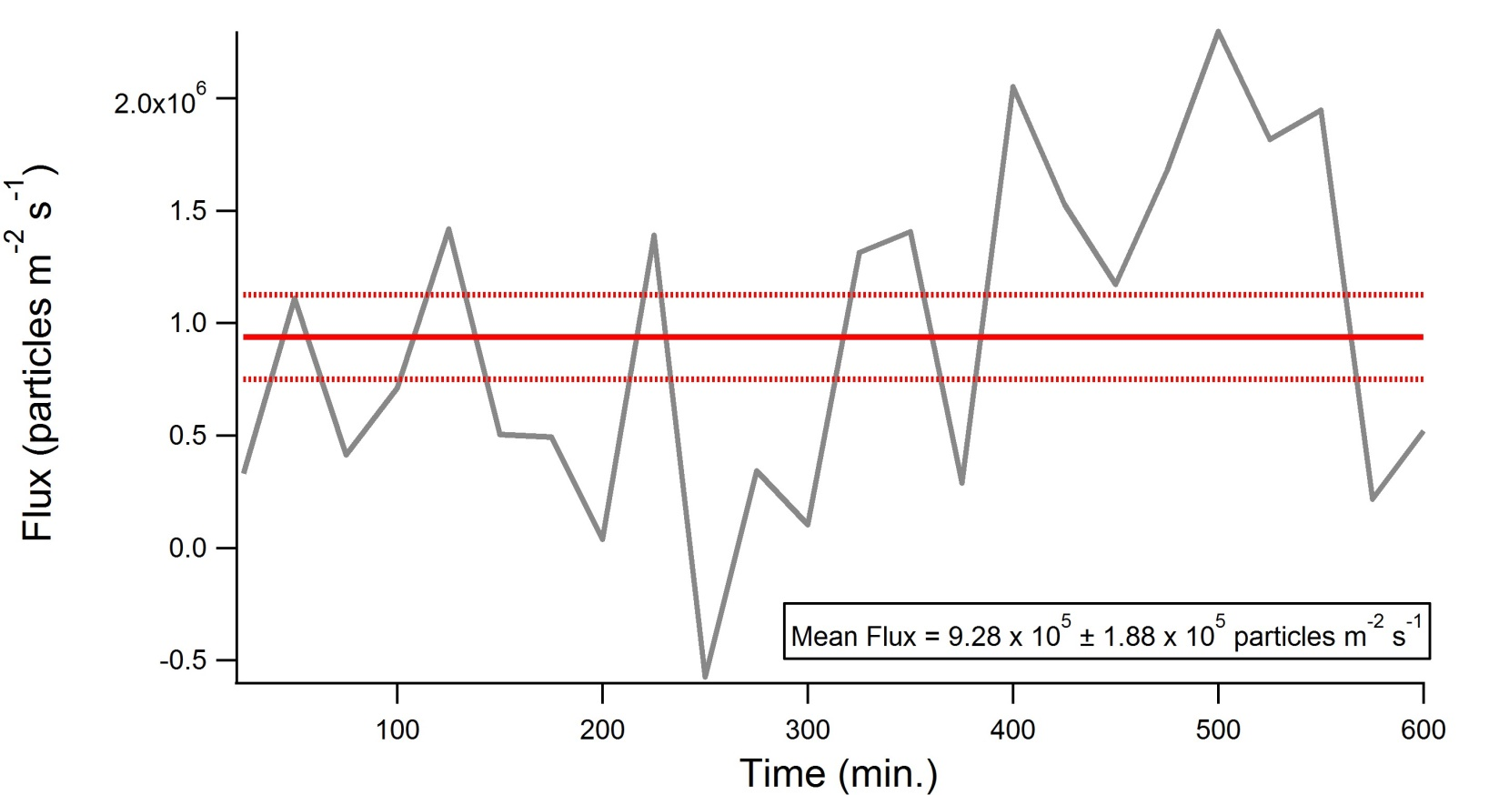
Preliminary System Results
High Source Strength
High Source Strength Flux Time Series

Slide 20
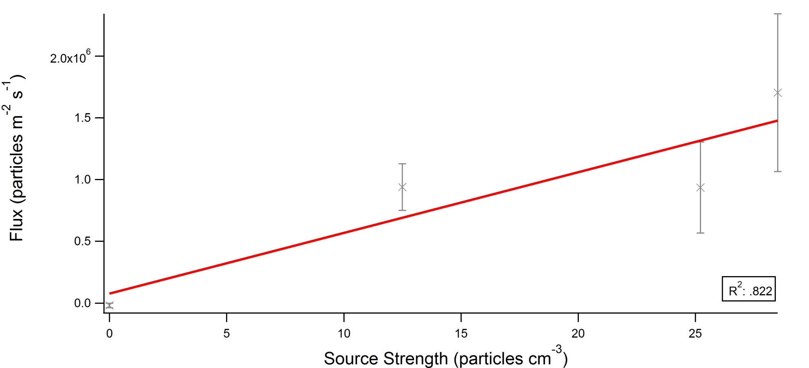
Preliminary System Results
Source Strength Vs. Flux

Slide 21
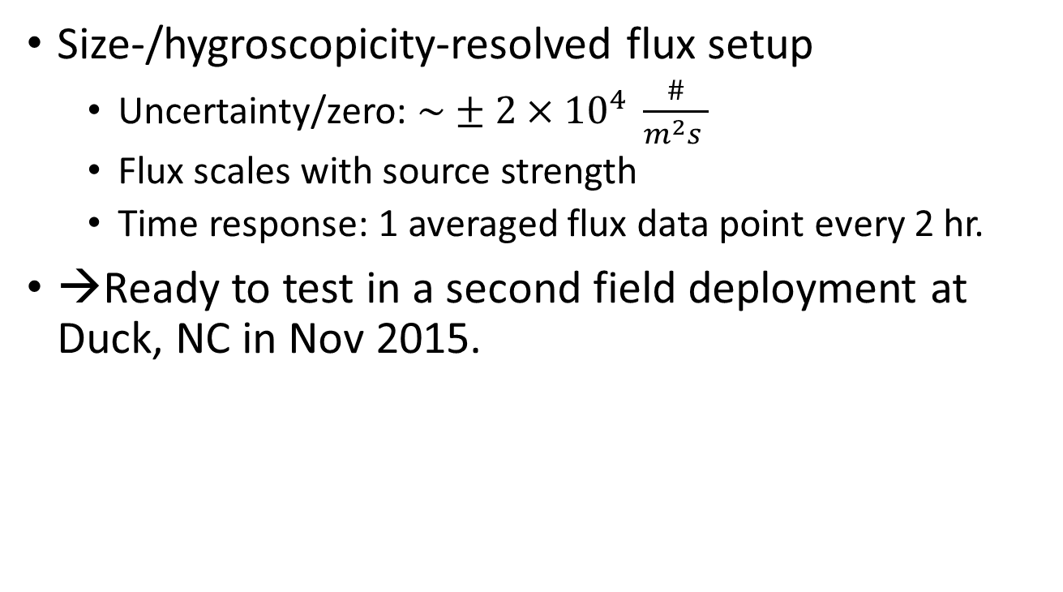
Flux Summary
Size-/hygroscopicity-resolved flux setup
  Uncertainty/zero: $\sim ±2×{10}^{4} \frac{\#}{m^{2}s }$
  Flux scales with source strength
  Time response: 1 averaged flux data point every 2 hr.
→Ready to test in a second field deployment at Duck, NC in Nov 2015.

Slide 22
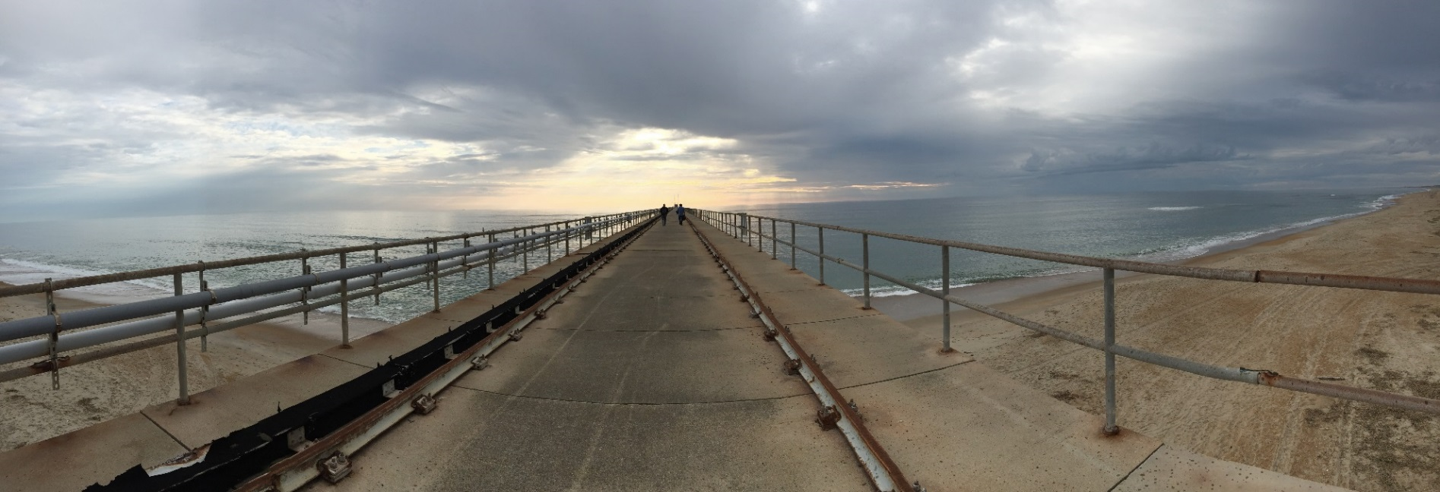
Questions?
Acknowledgements: National Science Foundation (NSF), and Field Research Facility (Jeff Waters) at Duck, NC

Slide 23
Ancillary u* Data

Slide 24
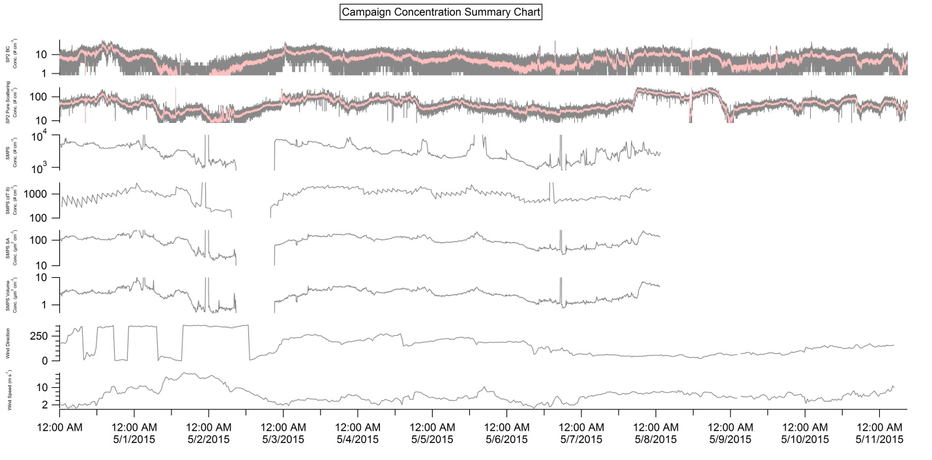
Ancillary SMPS/SP2 Data
SMPS Conc.
Surface Area
Volume

Slide 25
Ancillary Wind Rose Plot

Slide 26
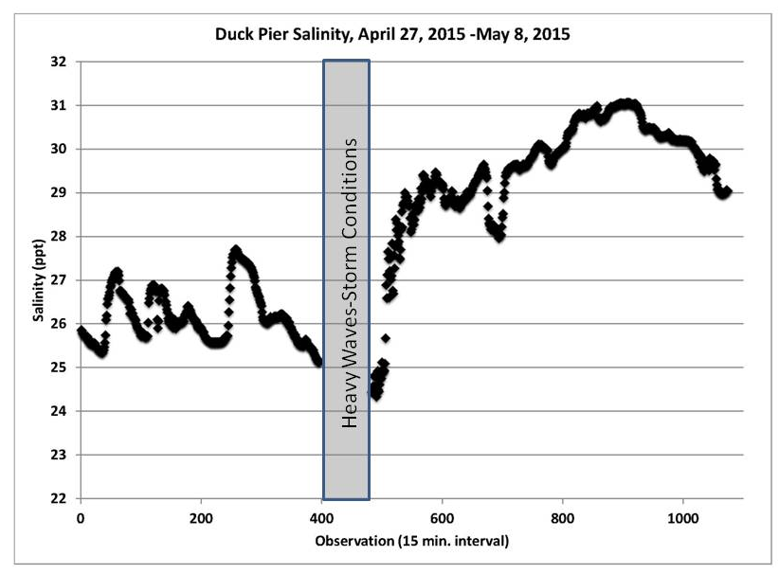
Ancillary Seawater Data

Slide 27
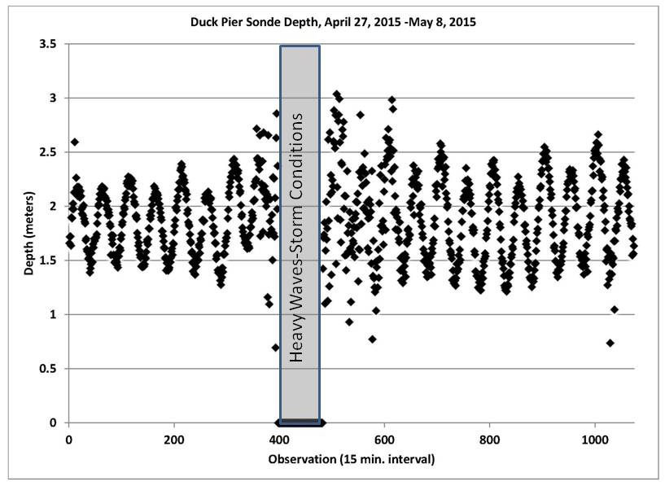
Ancillary Seawater Data

Slide 28
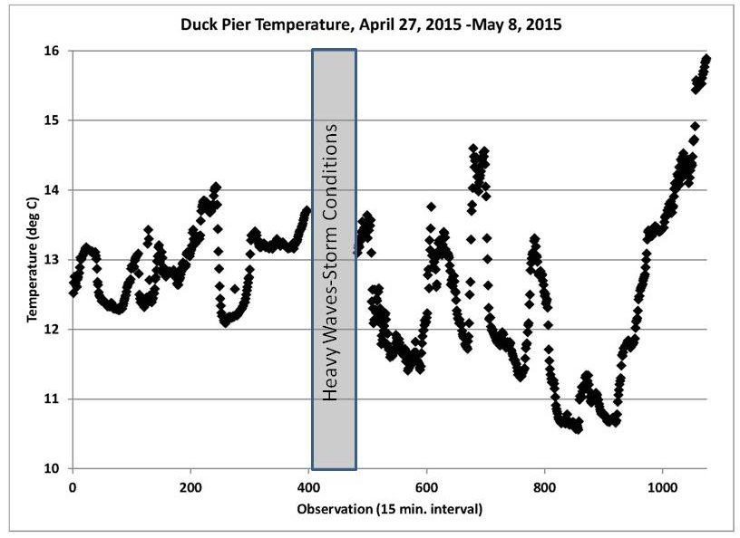
Ancillary Seawater Data

Slide 29
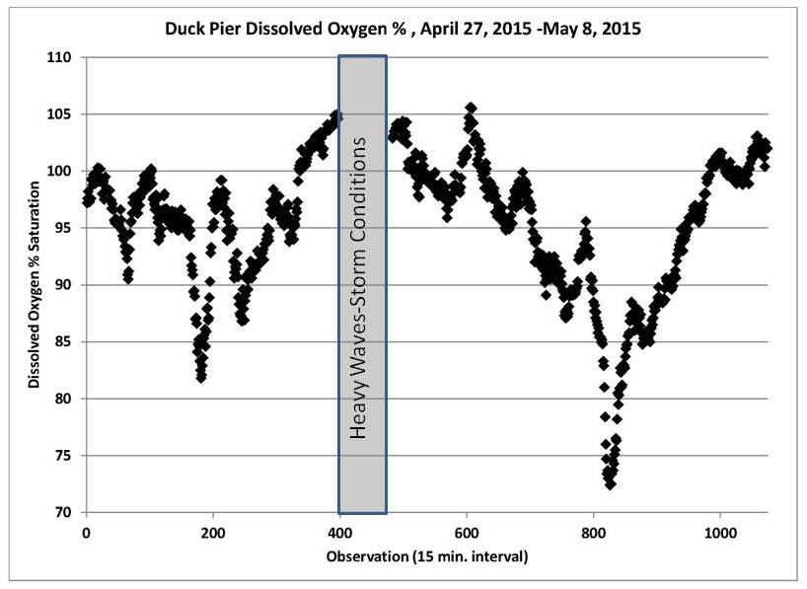
Ancillary Seawater Data

Slide 30
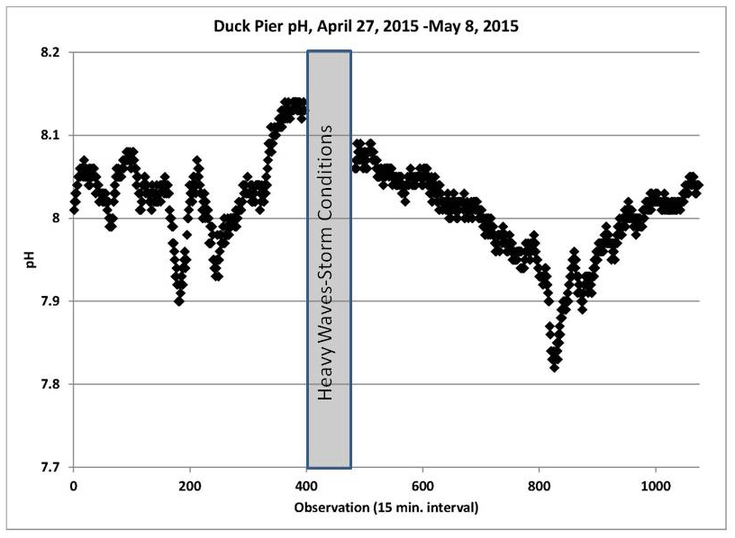
Ancillary Seawater Data

Slide 31
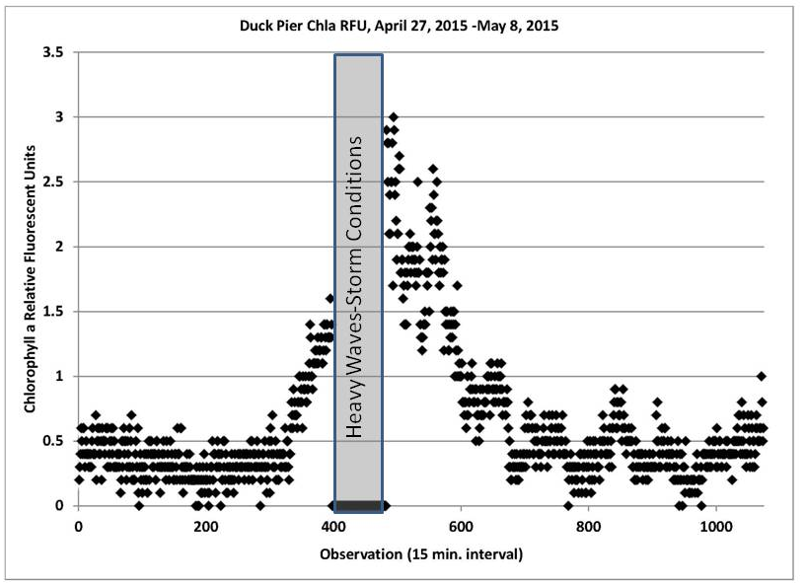
Ancillary Seawater Data
Notes:
RFU – Relative Florescence Units

Slide 32
Expected Valid Flux Results
Is the measured flux correct?
Given a change in the source concentration → flux should respond proportionally

